Slide 1
Housing Dashboard
(DB Ver)
By Raymond Song, Alan Zhang

Slide 2
Why Housing Dashboard?
You move to a new area and start looking for housing, you want to know how the listing compares to others
For similar listings in your area, is the listing more expensive or less expensive
Does it offer the amenities that you want?
Is the surrounding area convenient for living (Groceries, Transportation)?

Slide 3
Databases
MongoDB:
Best solution as we want to aggregate listings from multiple sources
Zillow, Apartment.com, Craigslist, listings from property websites
Listings gathered from the San Diego County
Store housing listings for easier aggregates.
Individual houses are not related through relationships

Slide 4
Databases (Cont.)
Neo4j:
Spatial package provides geographic search.
Houses are not stored in Neo4j, only passed along to neo4j as a tuple pair (lat, long) to find nearby businesses
Easier querying between Businesses and Categories as well as bus stops and routes

Slide 5
Prepping the raw data
Collected using a combination of web scraping and API
Unify features have different column names
E.g. num_baths instead of baths
Convert all of them to standard key
Ensure that data such as “$4,600+” gets stored as 4600 so it can be queried
Try to remove anomalies from the data
Tried to gather all amenities listed as its own column into one column named ‘amenities’

Slide 6
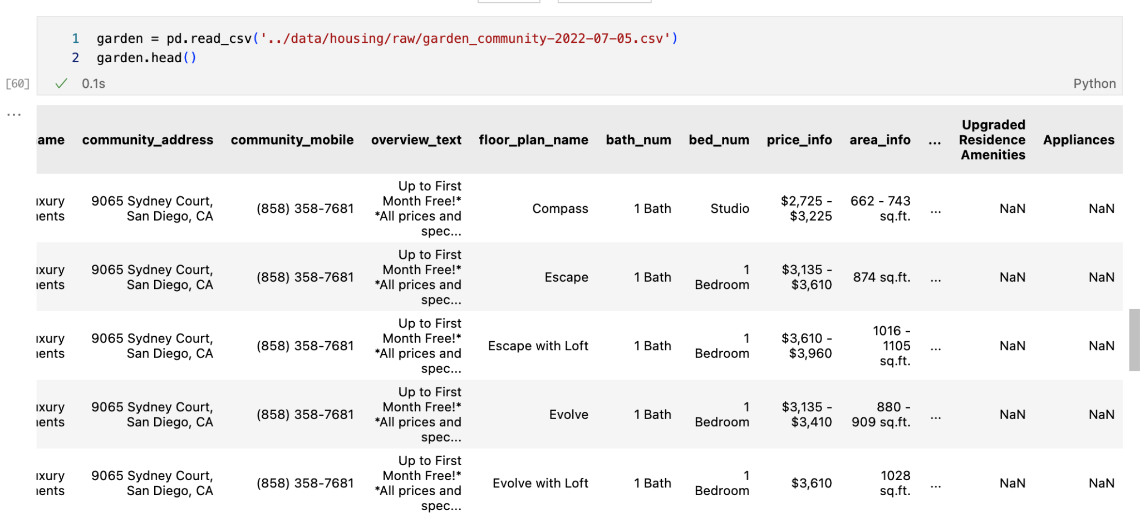

Slide 7
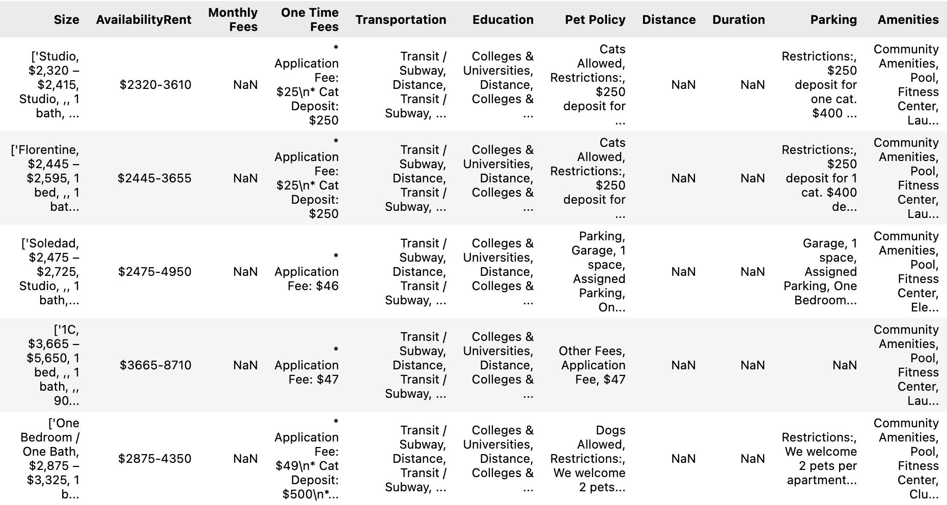

Slide 8
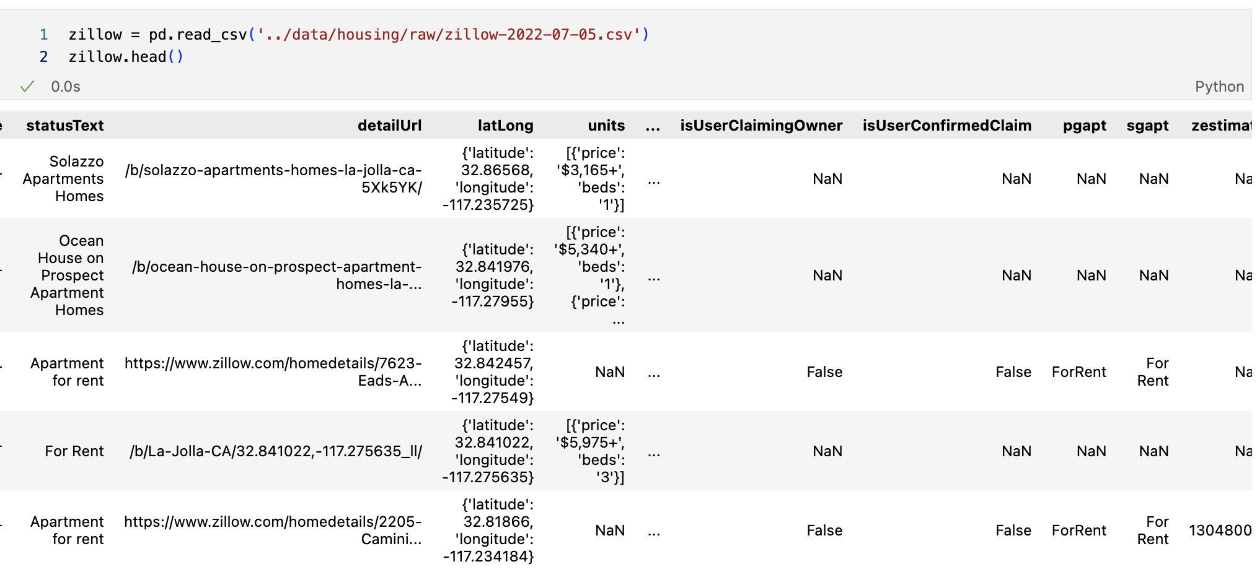
Need to extract latitude and longitude from the dictionary and get the price and beds for properties that have multiple listings

Slide 9
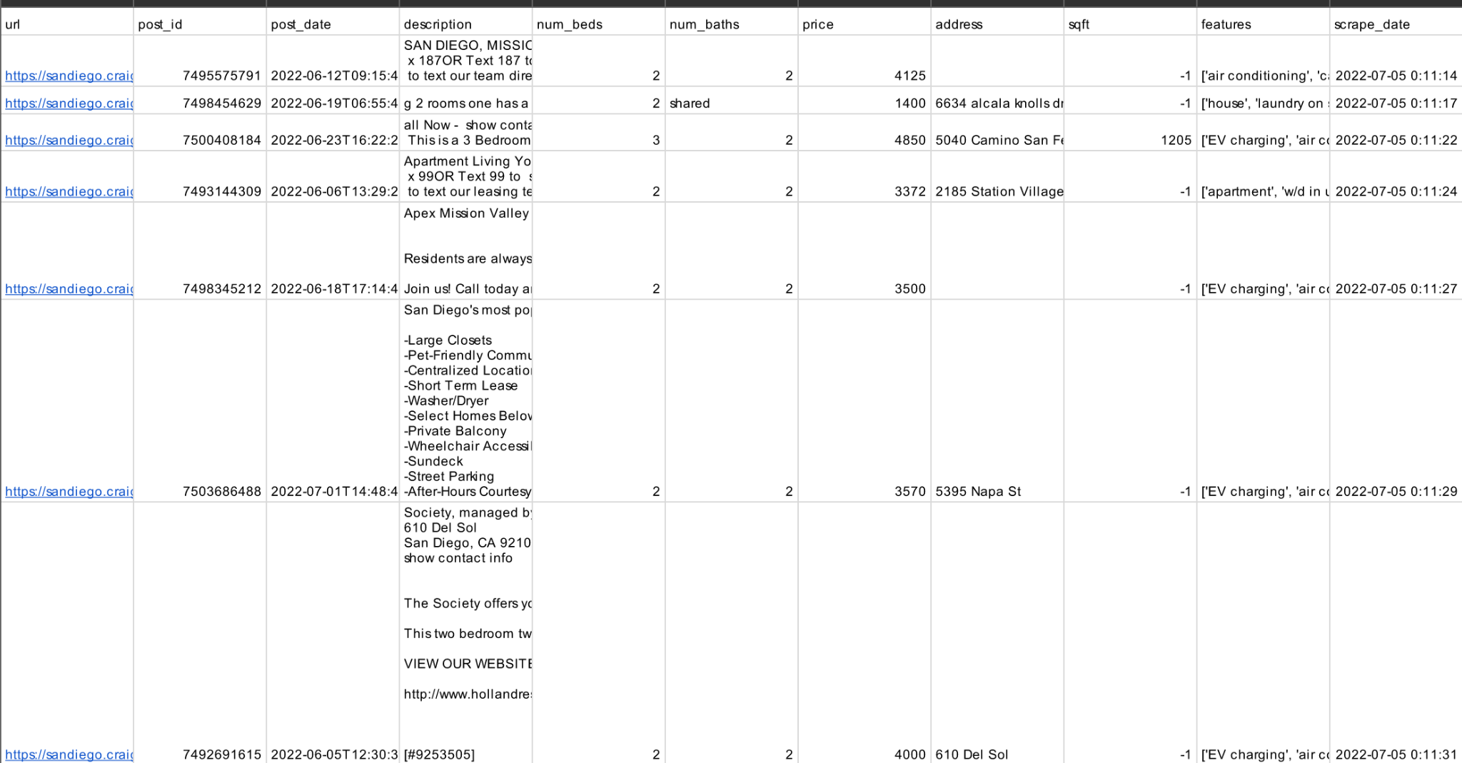

Slide 10
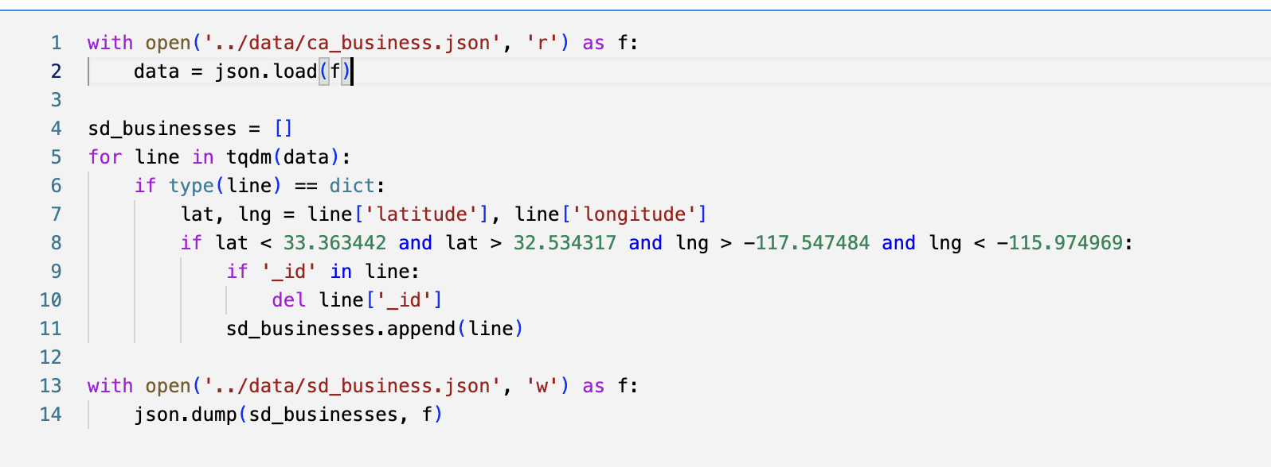
CA Businesses
JSON data gathered from the SDSC database and cleaned
Filtered down to SD businesses as businesses outside of the San Diego County will not have neighboring nodes
Save down on resources (for the scope of this project)

Slide 11
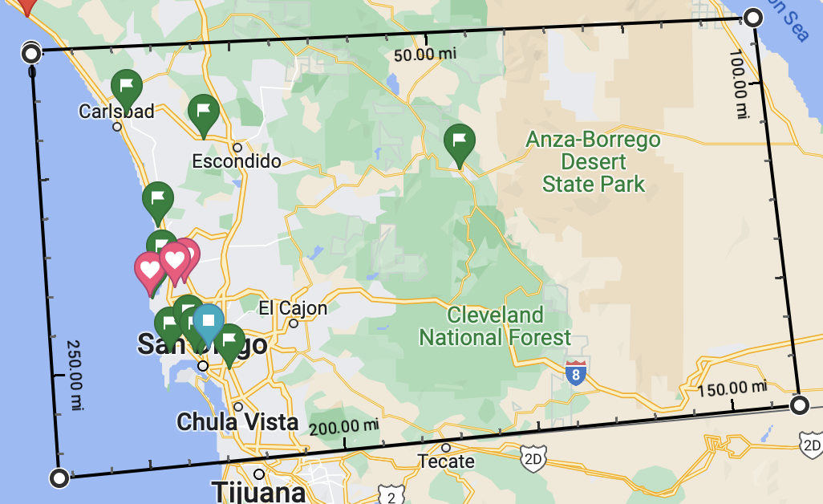

Slide 12
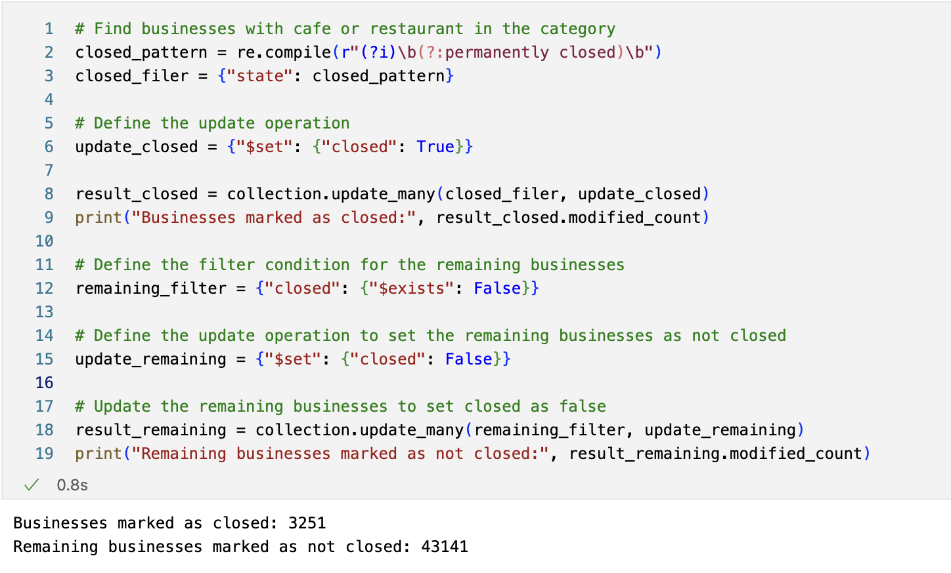
SD Business (Open)
Find out whether the business state is ‘permanently closed’ and remove it from the database

Slide 13
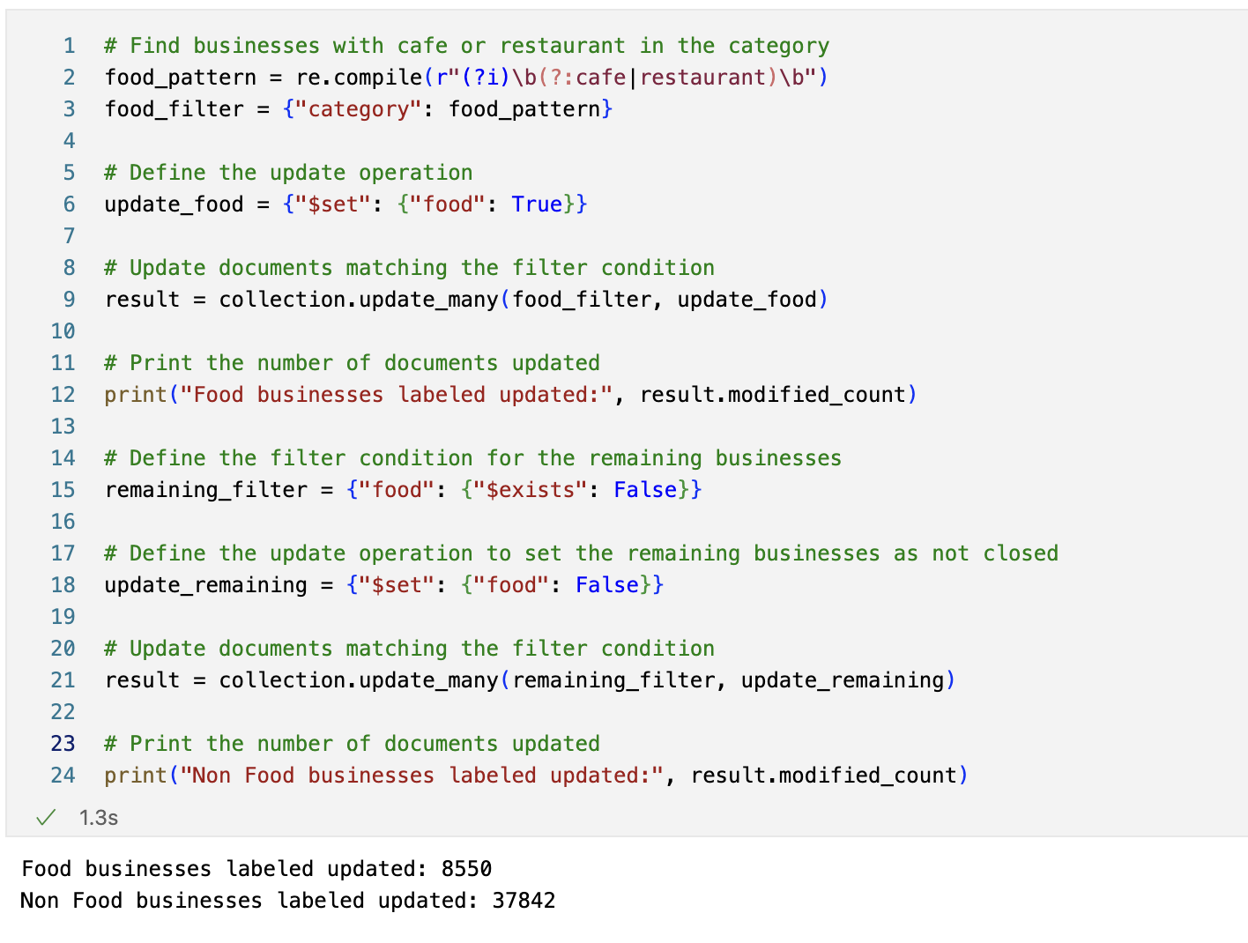
Cafes/Restaurants

Slide 14
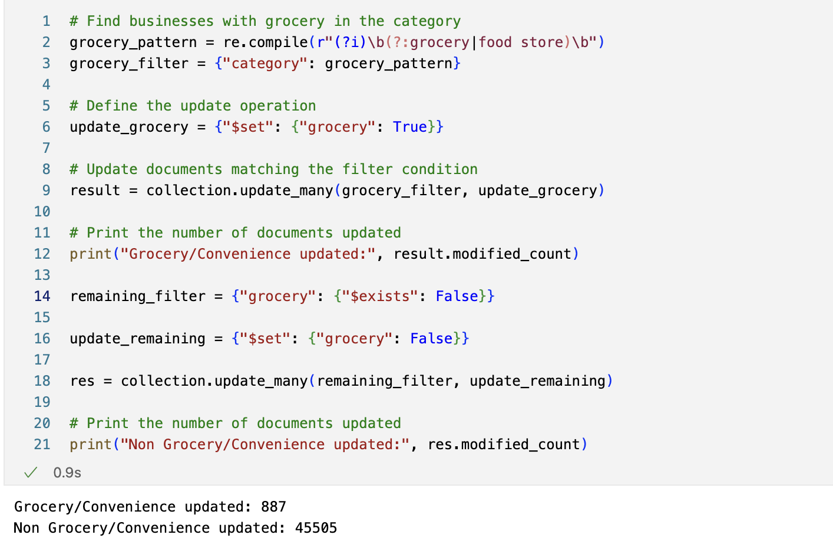
Grocery Stores

Slide 15
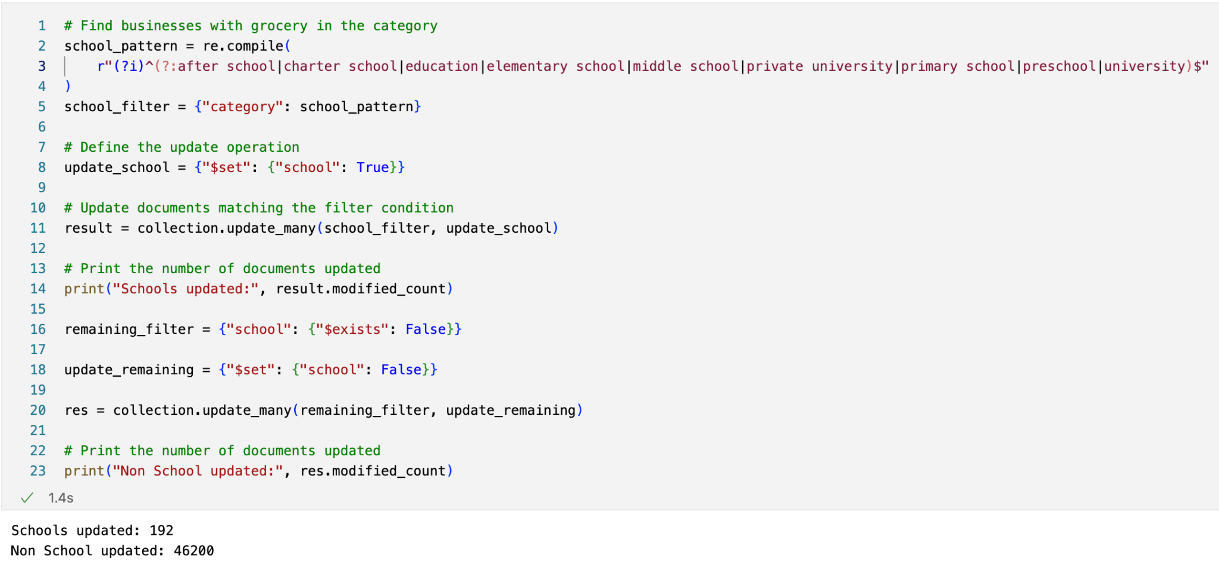
Schools

Slide 16
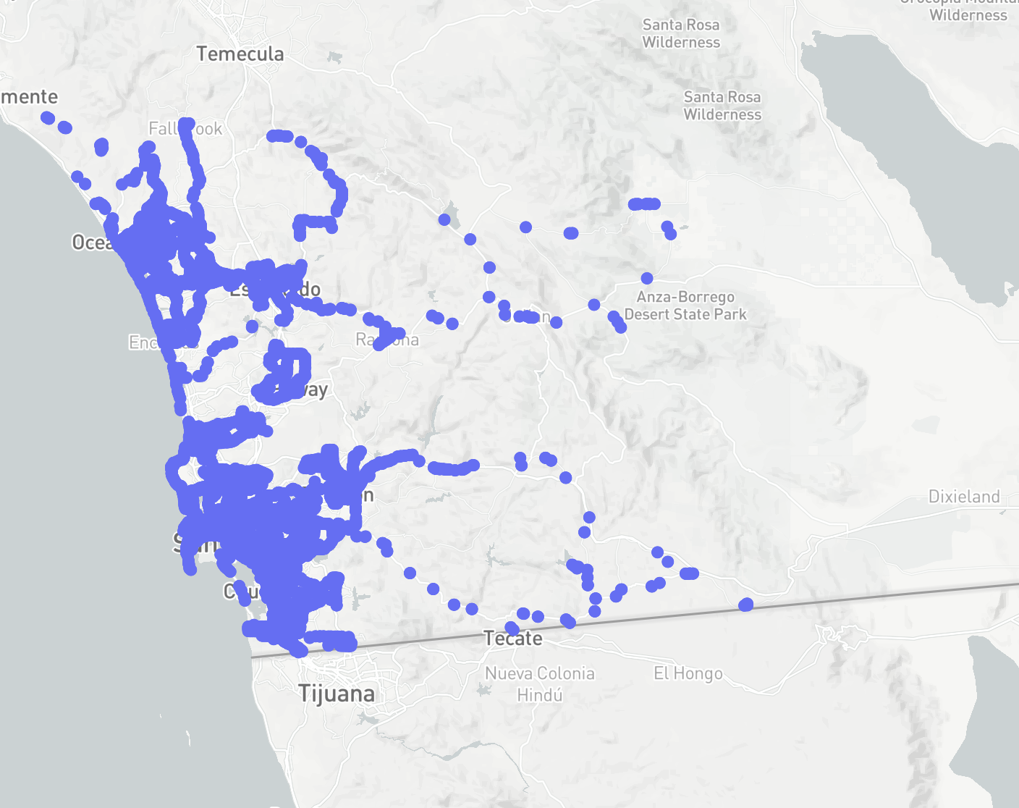
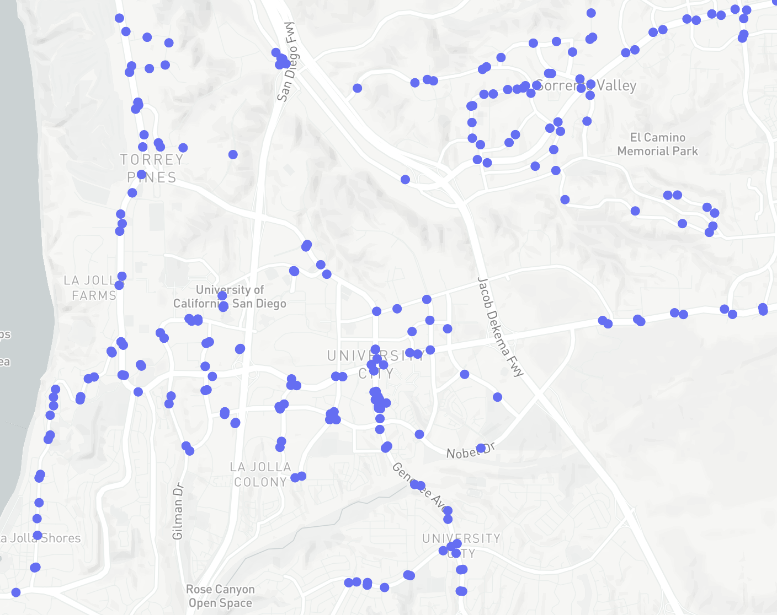
Bus stops

Slide 17
Filtering the listings
Price : 2400 - 4000, Sqft >= 850, In-Unit Washer Dryer, Allows pet

Slide 18
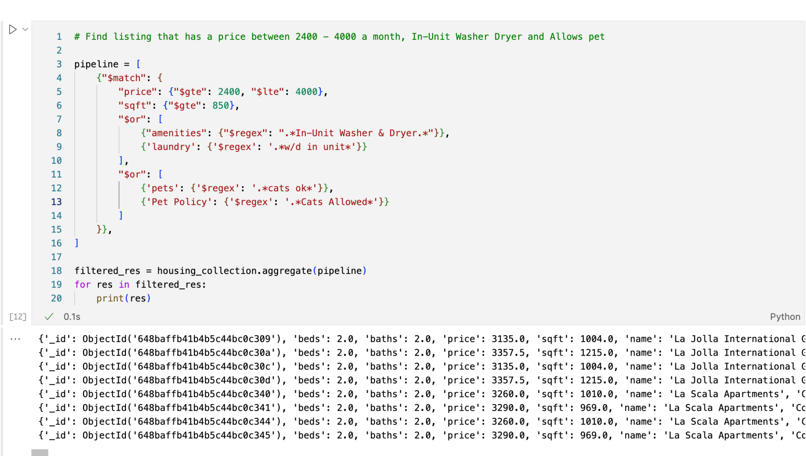

Slide 19
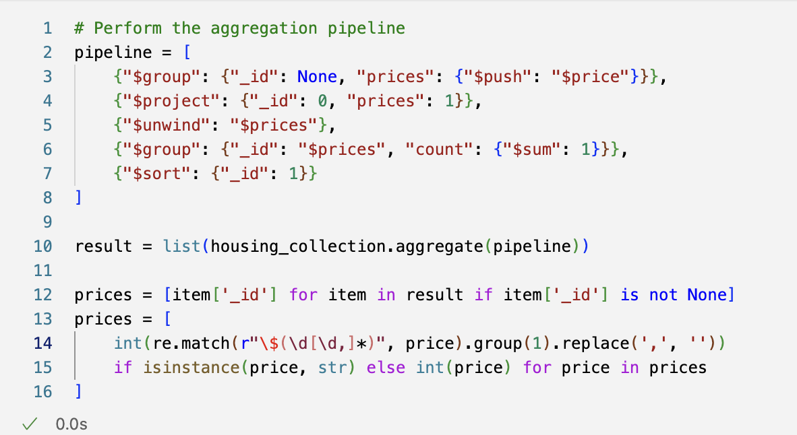
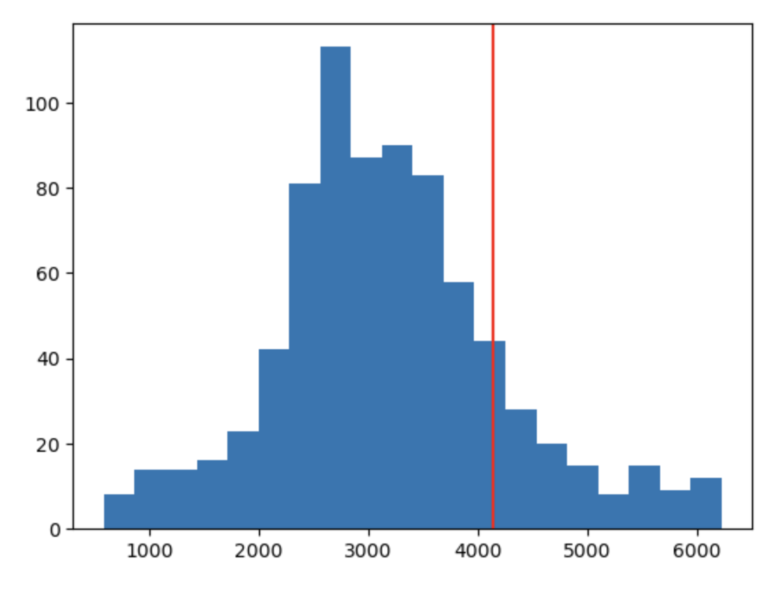
Pricing Distribution Query + Graph
Filter out outliers using the interquartile range method

Slide 20
Speedup improvement
Save the median, median, and standard deviation in a Redis database so that we can quickly draw up the gaussian distribution without querying all of the data and save one for each postal code.

Slide 21
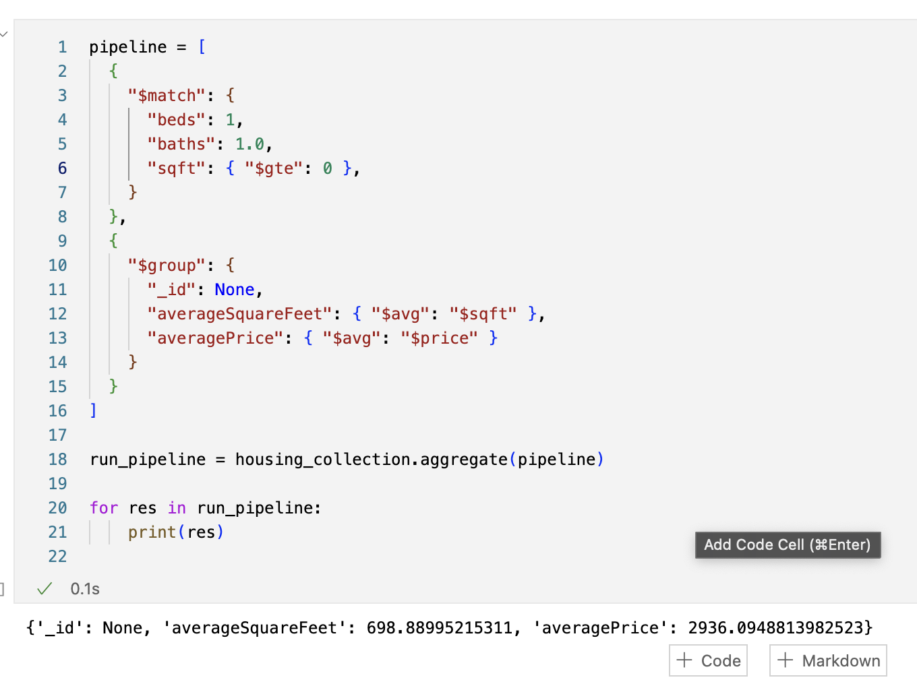
Average SQFT and Price
About 700 square feet on average and $2,937 per month
(Price accurate as to July 2022)

Slide 22
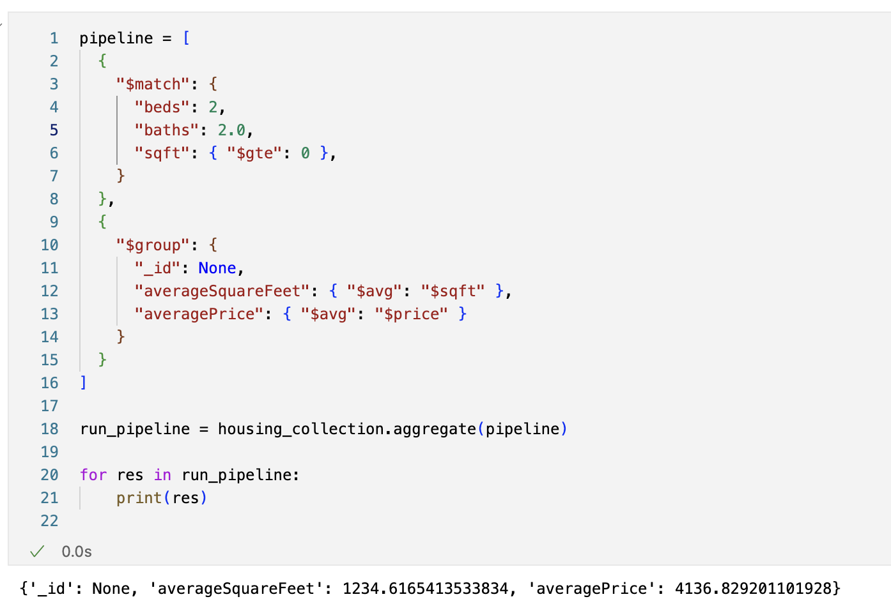
Average SQFT and Price
About 1230 square feet on average and $4,136 per month
(Price accurate as to July 2022)

Slide 23
Neo4j

Slide 24
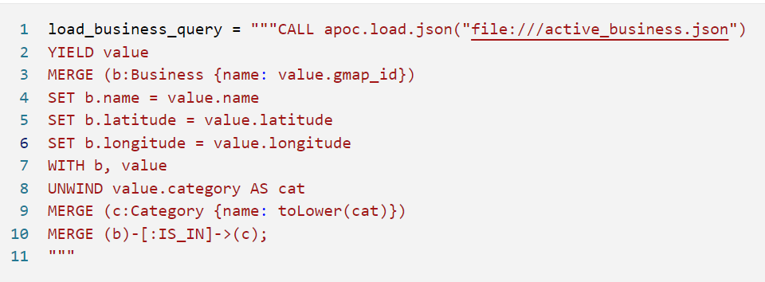

Businesses and Transit
Create Business and Category nodes
Add Businesses to Spatial Index
Similar to creating transit stops
Notes:
Using Neo4j 4.4.3 Because of the latest version of spatial is for neo4j 4.4.3

Slide 25
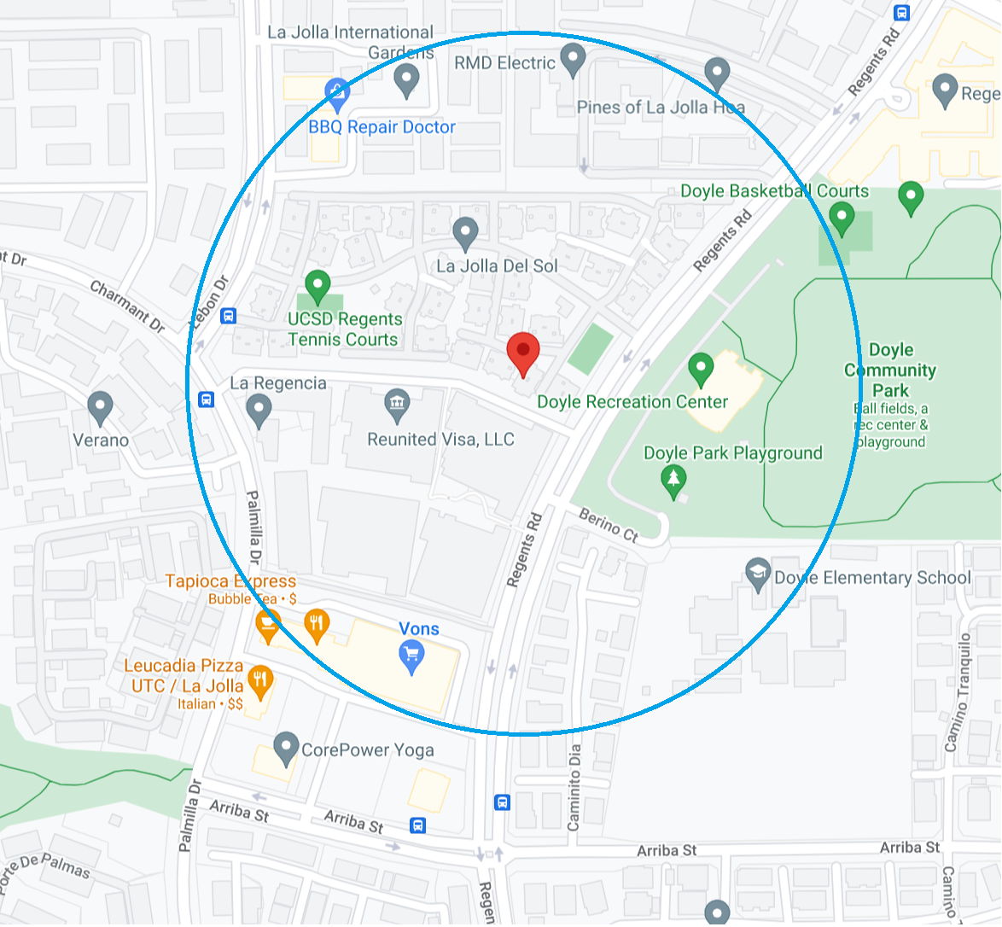
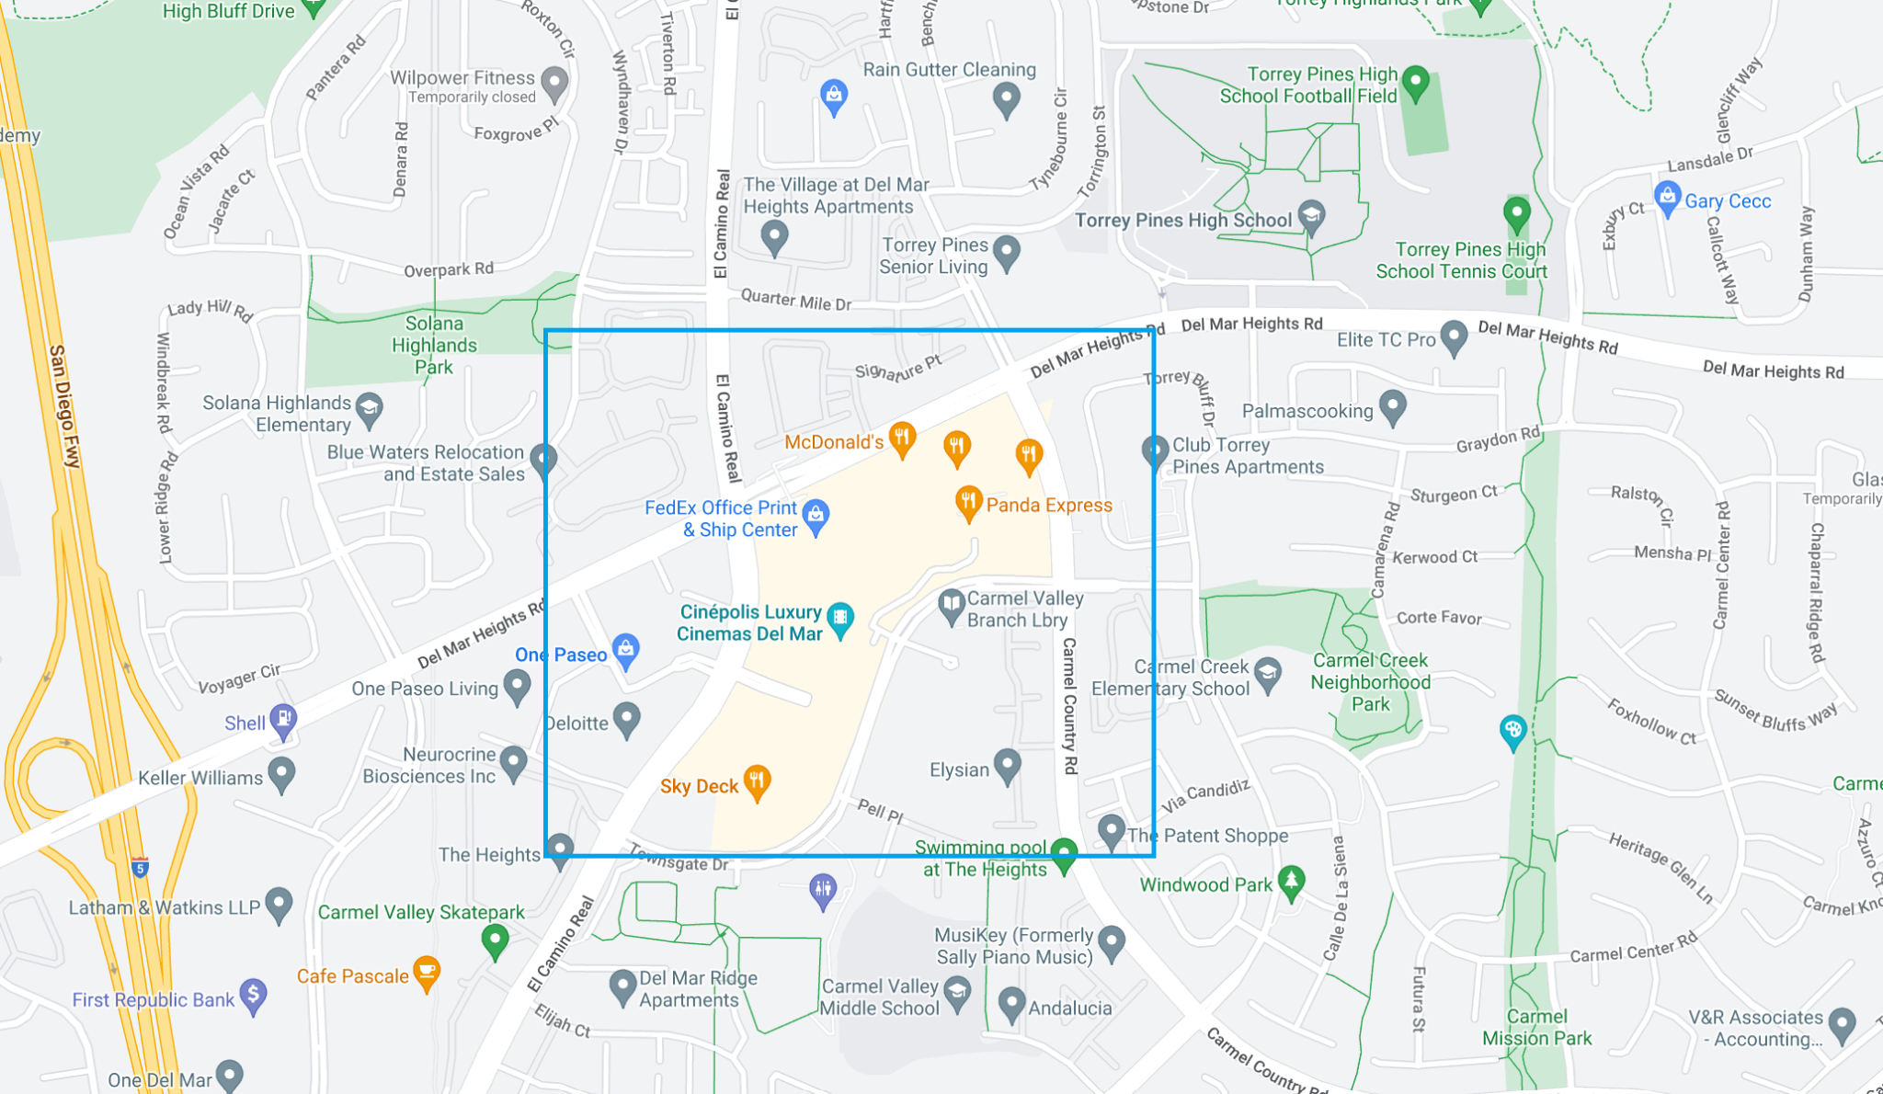
Neo4J Spatial
Allows for finding all nodes within a bounding box
Allow to find nodes within distance of point
Library Repo

Slide 26
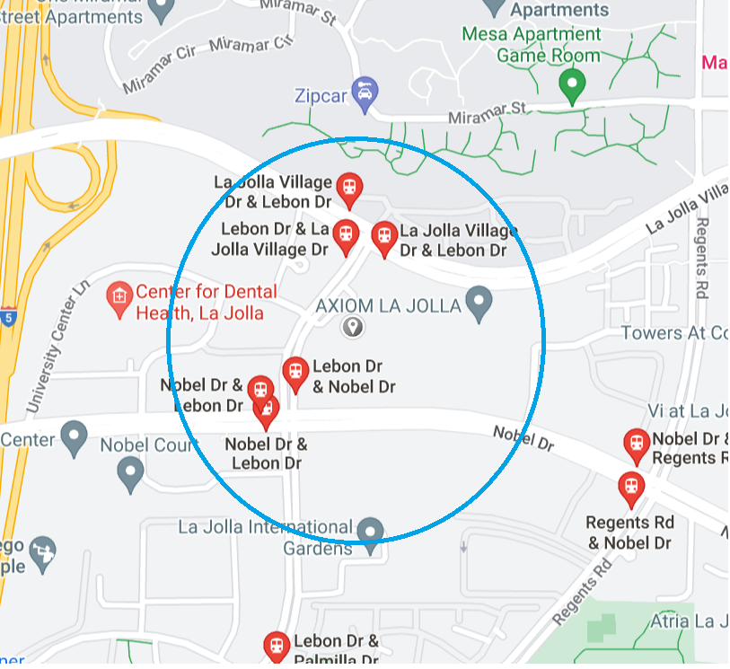
Queries
Bus stops within radius of point
Business with optional Category within radius of point

Slide 27
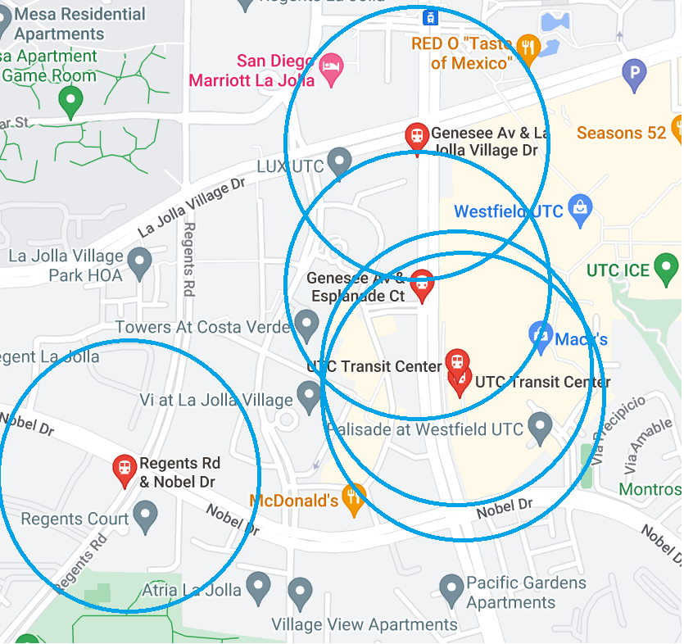
Queries (Cont)
Businesses with radius of all bus stops on a Route
Businesses and/or Bus Stops within bounding box

Slide 28
Neo4j Demo

